Slide 1

Why Use a Business Requirements Document (BRD) and How. The Key to Successful Projects
Notes:
“Hello, everyone. Today, I'll be talking about why a Business Requirements Document, or BRD, is crucial for successful projects and how it should be used. Let's get started.”

Slide 2
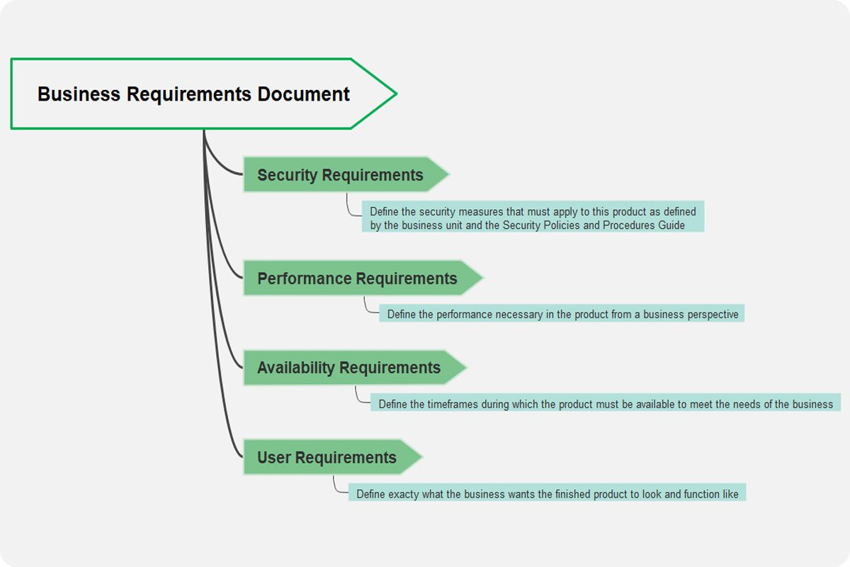
Introduction
What is a Business Requirements Document (BRD)?
A formal document outlining the business solution for a project.
Contains detailed project requirements from a business perspective.
Acts as a bridge between stakeholders and developers.
Notes:
“A BRD is a formal document that outlines the project’s business solution. It serves as a guide for the team and aligns stakeholders, developers, and clients around a common goal. Without it, a project can easily lose focus.”

Slide 3

Why is a BRD Important?
Importance of BRD
Clarity: Defines project objectives, scope, and deliverables clearly.
Alignment: Ensures all stakeholders are on the same page.
Accountability: Establishes roles and responsibilities.
Risk Mitigation: Helps identify potential risks early.
Notes:
“A BRD is important for four key reasons:
It brings clarity to the project goals and deliverables.
It ensures alignment between all stakeholders.
It assigns accountability for each task.
Finally, it helps to identify and manage risks early.”

Slide 4

Key Benefits of a BRD
Benefits of Using a BRD
Avoid Scope Creep: Prevents uncontrolled changes to the project scope.
Cost Efficiency: Reduces rework and budget overruns.
Time Management: Keeps the project on schedule.
Better Communication: Provides a common reference point for all stakeholders.
Notes:
“Some benefits of using a BRD are:
It prevents scope creep, ensuring that we stick to the original plan.
It helps manage costs and timelines more efficiently.
Finally, it improves communication among the team and stakeholders, acting as a single source of truth.”

Slide 5

Who Should Be Involved in BRD Creation?
Stakeholders Involved
Business Analysts: Lead the BRD process.
Project Managers: Oversee project timelines and resources.
Developers: Provide technical input.
Clients/End Users: Ensure their needs are addressed.
Quality Assurance Teams: Ensure requirements are testable.
Notes:
“The BRD involves different stakeholders:
Business Analysts lead the process.
Project Managers oversee timelines and resources.
Developers provide technical insight.
Clients or end-users ensure their needs are met.
And the QA team ensures requirements are testable.”

Slide 6
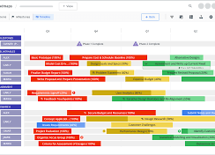
When Should a BRD Be Created?
Ideal Timing for BRD Creation
At the start of the project lifecycle.
Before any development work begins.
After initial stakeholder consultations and project scoping.
Notes:
“A BRD should be created at the start of a project, before any development begins, and after initial consultations with stakeholders. This ensures the project has a clear direction from the outset.”

Slide 7
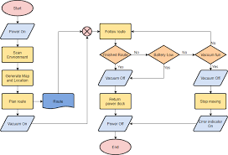
Key Sections of a BRD
Essential Sections in a BRD
Project Overview
Business Objectives
Scope of Work
Functional Requirements
Non-functional Requirements
Assumptions and Constraints
Acceptance Criteria
Notes:
“Every BRD has a few key sections:
Project Overview
Business Objectives
Scope of Work
Functional and Non-functional Requirements
Assumptions, Constraints, and Acceptance Criteria Each of these plays a critical role in defining the project.”

Slide 8
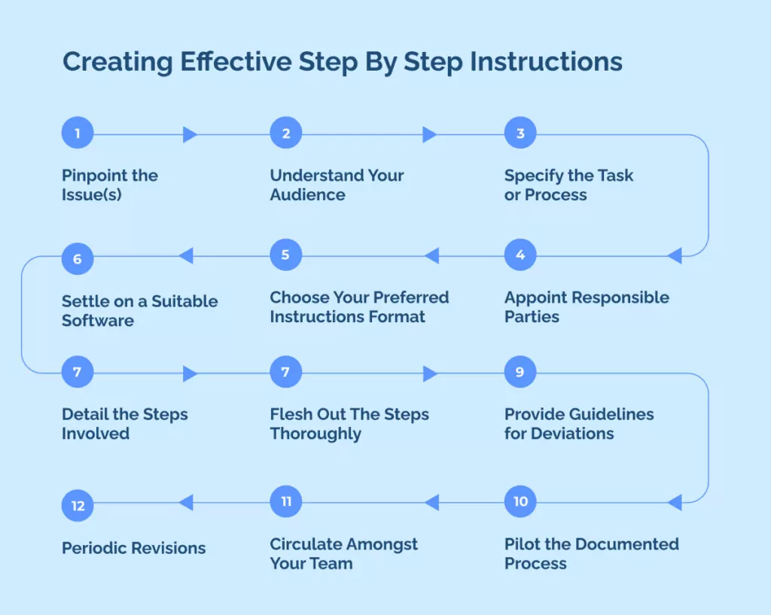
Steps to Create a BRD
Steps for BRD Creation
Identify Stakeholders: Gather input from all relevant parties.
Gather Requirements: Conduct interviews, workshops, or surveys.
Define Objectives and Scope: Clarify the goals and deliverables.
Write the Document: Organize information into clear sections.
Review and Approve: Ensure all stakeholders agree on the content.
Notes:
“To create a BRD, follow these steps:
Identify and involve stakeholders.
Gather requirements through interviews or workshops.
Define project objectives and scope clearly.
Write the document.
Finally, review and approve it with all stakeholders.”

Slide 9

How to Use the BRD Effectively
Best Practices for Using a BRD
Regularly Update the BRD: Keep it up-to-date with any changes.
Use as a Reference: Consult it throughout the project lifecycle.
Involve Stakeholders in Reviews: Ensure continuous alignment.
Track Progress: Use it to measure milestones and deliverables.
Notes:
“Once the BRD is created, it should be updated regularly and used as a reference throughout the project. It helps track progress and ensures everyone stays aligned with the original goals.”

Slide 10

Challenges of BRD
Challenges in Using a BRD
Ambiguity: Requirements may be unclear or vague.
Changing Requirements: The project may evolve over time.
Over-detailed Documents: Can lead to confusion or rigidity.
Stakeholder Conflicts: Differing priorities may cause friction.
Notes:
“While a BRD is helpful, it’s not without challenges.
Requirements can be unclear.
The project scope may change.
Some documents can be overly detailed, which can cause confusion. These are challenges to be mindful of.”

Slide 11

Conclusion
A BRD is crucial for project success.
Helps in managing scope, cost, time, and risks.
Regular reviews and updates ensure project alignment.
Clear communication tool for all stakeholders involved.
Notes:
“In conclusion, a BRD is a vital tool for managing scope, cost, and time in any project. It keeps everyone aligned and ensures the project’s success. Thank you.”

Slide 12

Questions

